Slide 1
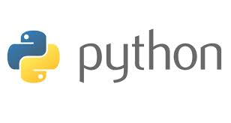
Feb 1, 2016
For Fun and Profit!

Slide 2
Python
Intro
Why Python?
Getting Started- Installation Options & Orientation
Editing + running scripts
How to research APIs aka Finding out what’s possible
Additional Resources

Slide 3








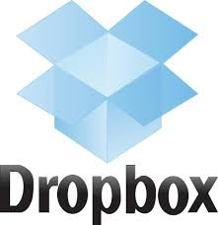


What do all these organizations have in common?

Slide 4

Python
Intro
They all use Python!
What can you do with Python?
You can…
Build a website
Create a video game
Remix music
Make mobile apps- FLAPPY BIRD!!!
Pull, clean, analyze and visualize data!!!
Notes:
Python is a popular & (relatively) easy to learn programming language. It was created in the late 80s and is named after the comedy troupe Monty Python.
You can use Python to pull, clean, analyze and visualize data. And in our case, we can write scripts that automate things that would be a total pain in Excel. Pulling & storing data, querying data, etc. You can also do this with R, but R has a steeper learning curve, so I’ll touch on R at the end.

Slide 5
Sample Research Questions

Slide 6
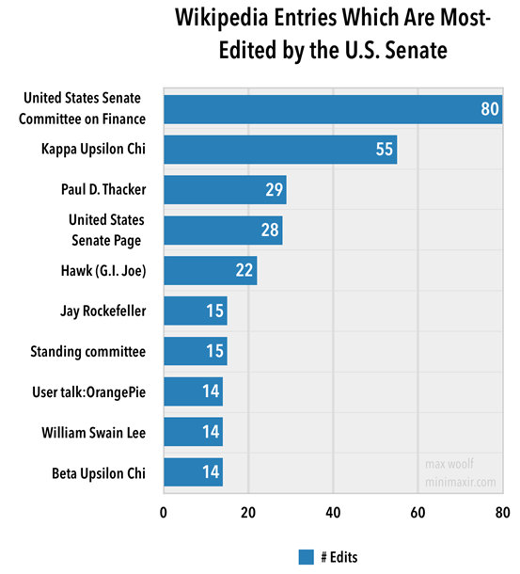
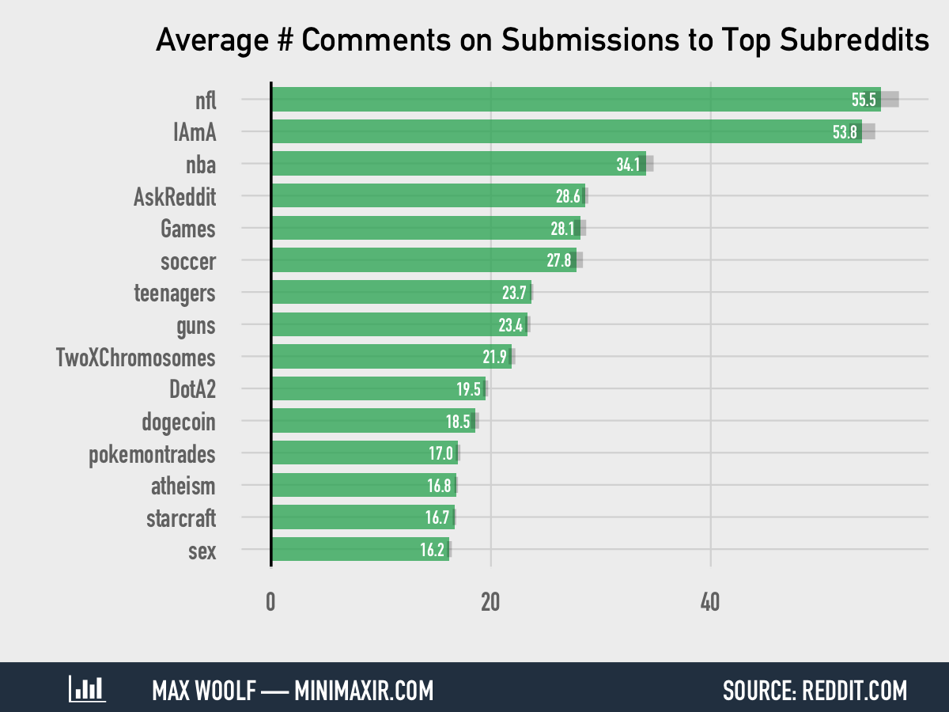
Python
Sample Use cases
Which Subreddits have the most active communities?
Which senators edit their Wikipedia pages most often?

Slide 7
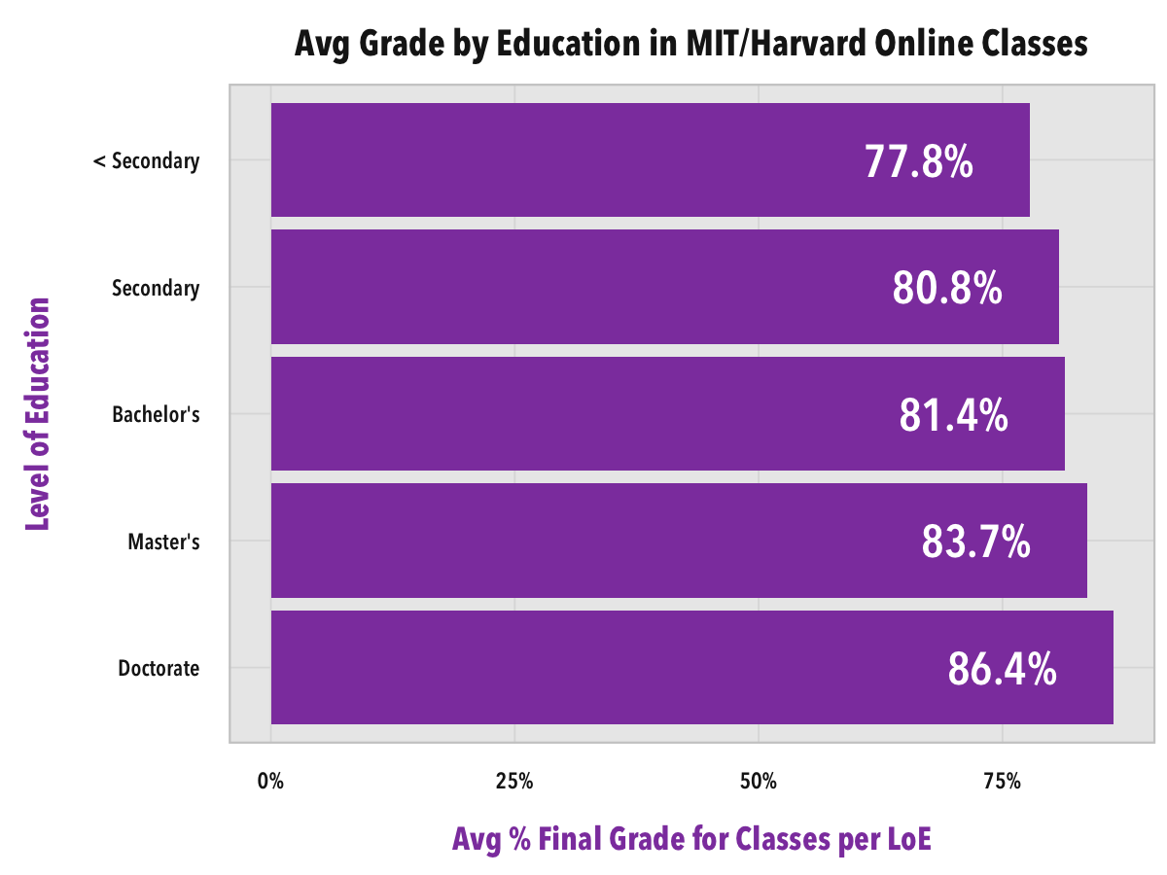
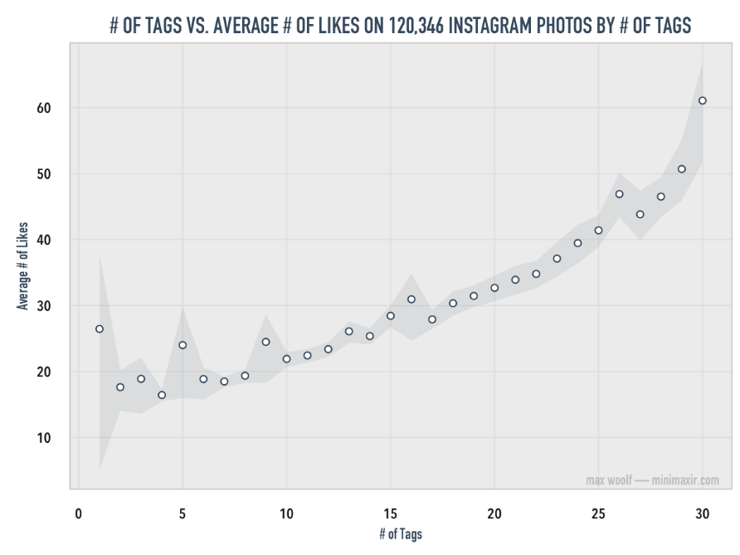
Python
Sample Use cases
Is there any difference in how people of different education levels fare in MOOCs?
Does spamming hashtags on Instagram actually lead to getting more total likes?

Slide 8

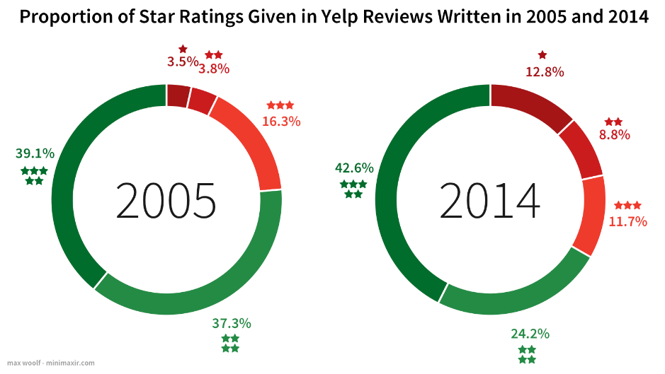
Python
Sample Use cases
What’s the difference between 1 Star & 5 Star Yelp reviews?
Are Yelp reviews generally more negative than they used to be when the review site first started?

Slide 9
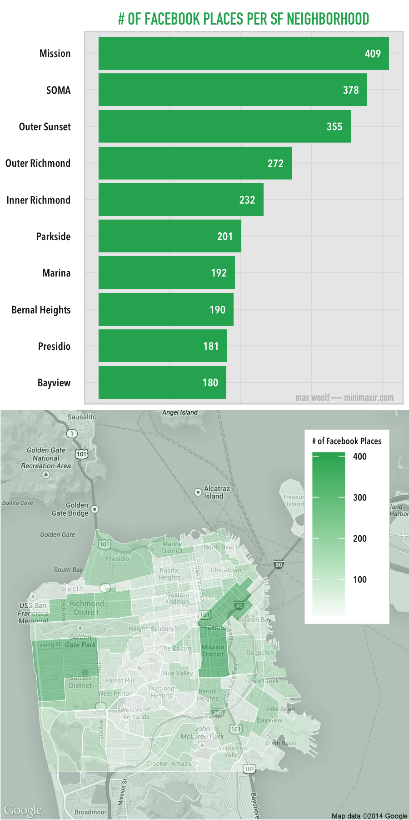
Python
Sample Use cases
What are the most popular San Francisco neighborhoods for Facebook check ins?

Slide 10
Getting started…

Slide 11
Python
Command line & Text editor
Installation-Please click through the linked installation tutorials located in the Additional Resources Section.
Note: Mac OS 10.8 comes with Python 2.7 pre-installed.
Python 2 (not 3!). Things you learn in 2 translate to 3, but not the other way around. Also a lot of the good data modules are built for 2.
A simple text editor (Notepad ++ for Windows or TextWrangler for Mac)
Or you could install a full IDE (integrated development environment).
Python X,Y
Notes:
At the most basic level, we need to download and install Python & a text editor, so we can write & save programs. Python can be run through the command line interface.
IDEs are made to have all the things that programmers need in one place. For example, they usually include the actual program, built in text editors, debuggers, the most popular modules come pre-installed.
Python (XY) is a free scientific & engineering development software for numerical computations, data analysis and data visualization. Basically Python XY installs Python 2.7 plus a text editor & interpreter and many popular data analysis modules are preinstalled. A time saver, but this file is super big and can take 30 min-1 hour to download.

Slide 12
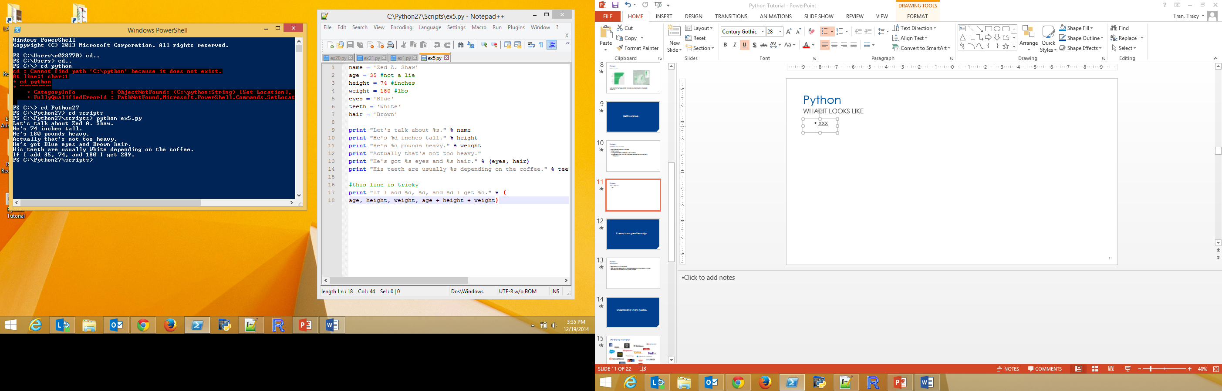
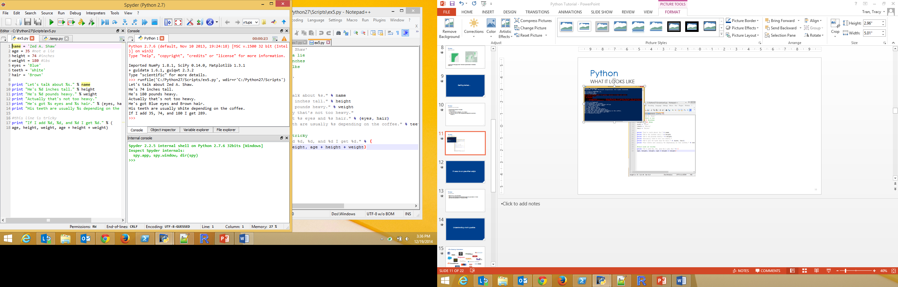
Python
What it looks like
Command Line Interface & Text Editor
IDE
Notes:
To the left you’ll see what it looks like if you’re just working in the Command Line Interface and writing programs in the Text Editor. The Command Line is like Windows Explorer- you can navigate your computer’s folders & run programs through it. It’s just a text based interface instead of graphical.
Text editors are like Microsoft Word for programs. As you’re writing a program, the editor will highlight any mistakes you make. Super helpful.
To the right is what happens when you launch Spyder, the programming environment that comes with the Python (x,y) package. You’ve got your text editor, a console that mimics the command line/Terminal and a debugger. It’s customizable, so you can add and subtract other features. For example, a history of your last steps, or a list of the variables that you created. Just a quick note- the console can’t do everything Terminal does. You will need to use the Terminal to install modules.

Slide 13
Python
Editing & Running scripts
EDITING
Open the file in your text editor. Look for where to change the parameters specific to your search. In Python comments are denoted with #, so look for those.
Save the file somewhere easy to find, perhaps in a dedicated scripts folder within your Python folder.
RUNNING SCRIPTS
Using the Command Line, navigate to the folder where your program is saved. Then type “python nameofprogram.py” in the Command Line. This starts Python and runs the program.
USING PYTHON XY:
Open Python X,Y and load the script using “Open”. You can make changes to the text in the text editor. Press Save.
Press the green arrow key to run the file.

Slide 14
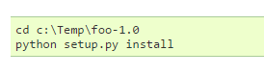
Python
Installing modules
Why write code from scratch if somebody else has already written it? Somebody has probably already written code for pulling data from Instagram, for example. A simple Google search or checking GitHub will tell you what’s out there.
You can import modules in your program simply by invoking the module with “import x” at the beginning of the program. But first you have to install the module!
Other OPTION: Install the pip module the old fashioned way. Moving forward, use the syntax “Pip install nameofmodule” to install x module. That’s it- no searching for the file, no downloading, no saving the file & running the setup.py file as I showed above. To uninstall, use “pip uninstall X”
You do not have to have Python running to use pip.
Notes:
You can install modules manually by downloading them (watch where you save the file!). Then you navigate to the folder using the Command Line and run the installation command.
In the example lines above, the program foo-1.0 was downloaded into the Temp folder. We navigate there in the Command line, using “cd” and “cd..” to get to the folder that we want. Then to run the program we type python setup.py install
Another option is to download the module Pip, which makes future module installation much easier. You won’t have to manually download the module file and navigate to the exact folder, etc. Pip searches for the module you name, then downloads & installs it. Pip also helps you uninstall programs. Pip has to be used from the command line.

Slide 15
Python
Social media api project ideas
Downloading data from the Instagram API
Identifying Overlap in Users’ Twitter Followers
Facebook Historical Post Interaction Downloads
Note: all 3 of these programs would need authentication credentials to pull data. Basically to get these credentials you create a fake app. Once you have the Instagram & Twitter passwords, you can use them forever. Facebook is a little bit more complicated. You have to update your code every 60 days. This is kind of complicated, so let me know if you need a walk through.

Slide 16
Understanding what’s possible

Slide 17
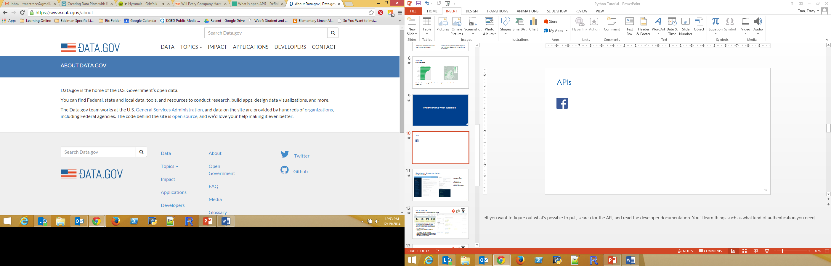


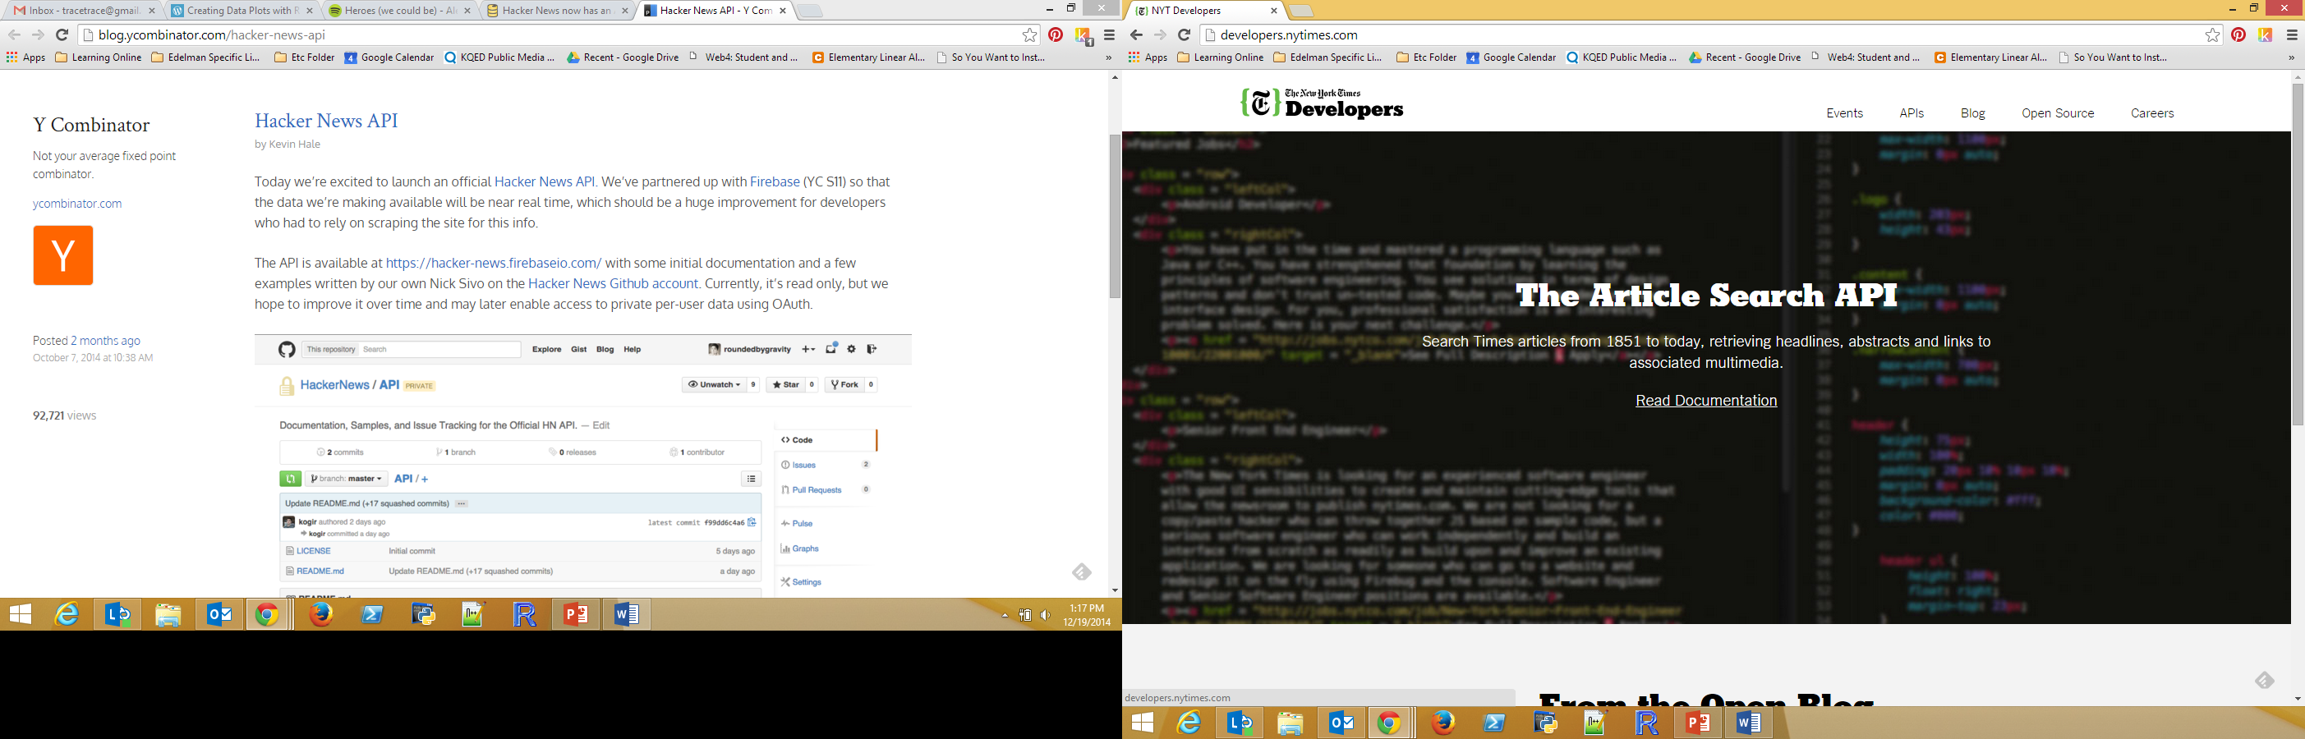


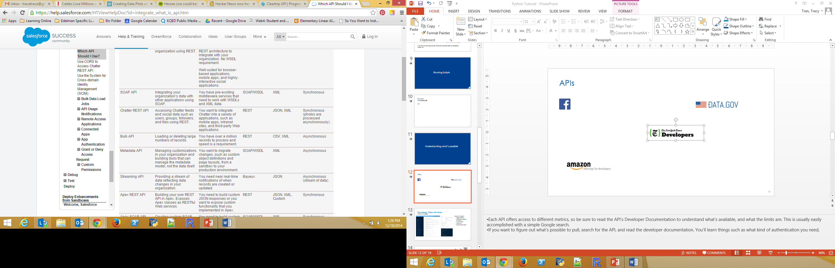



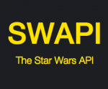

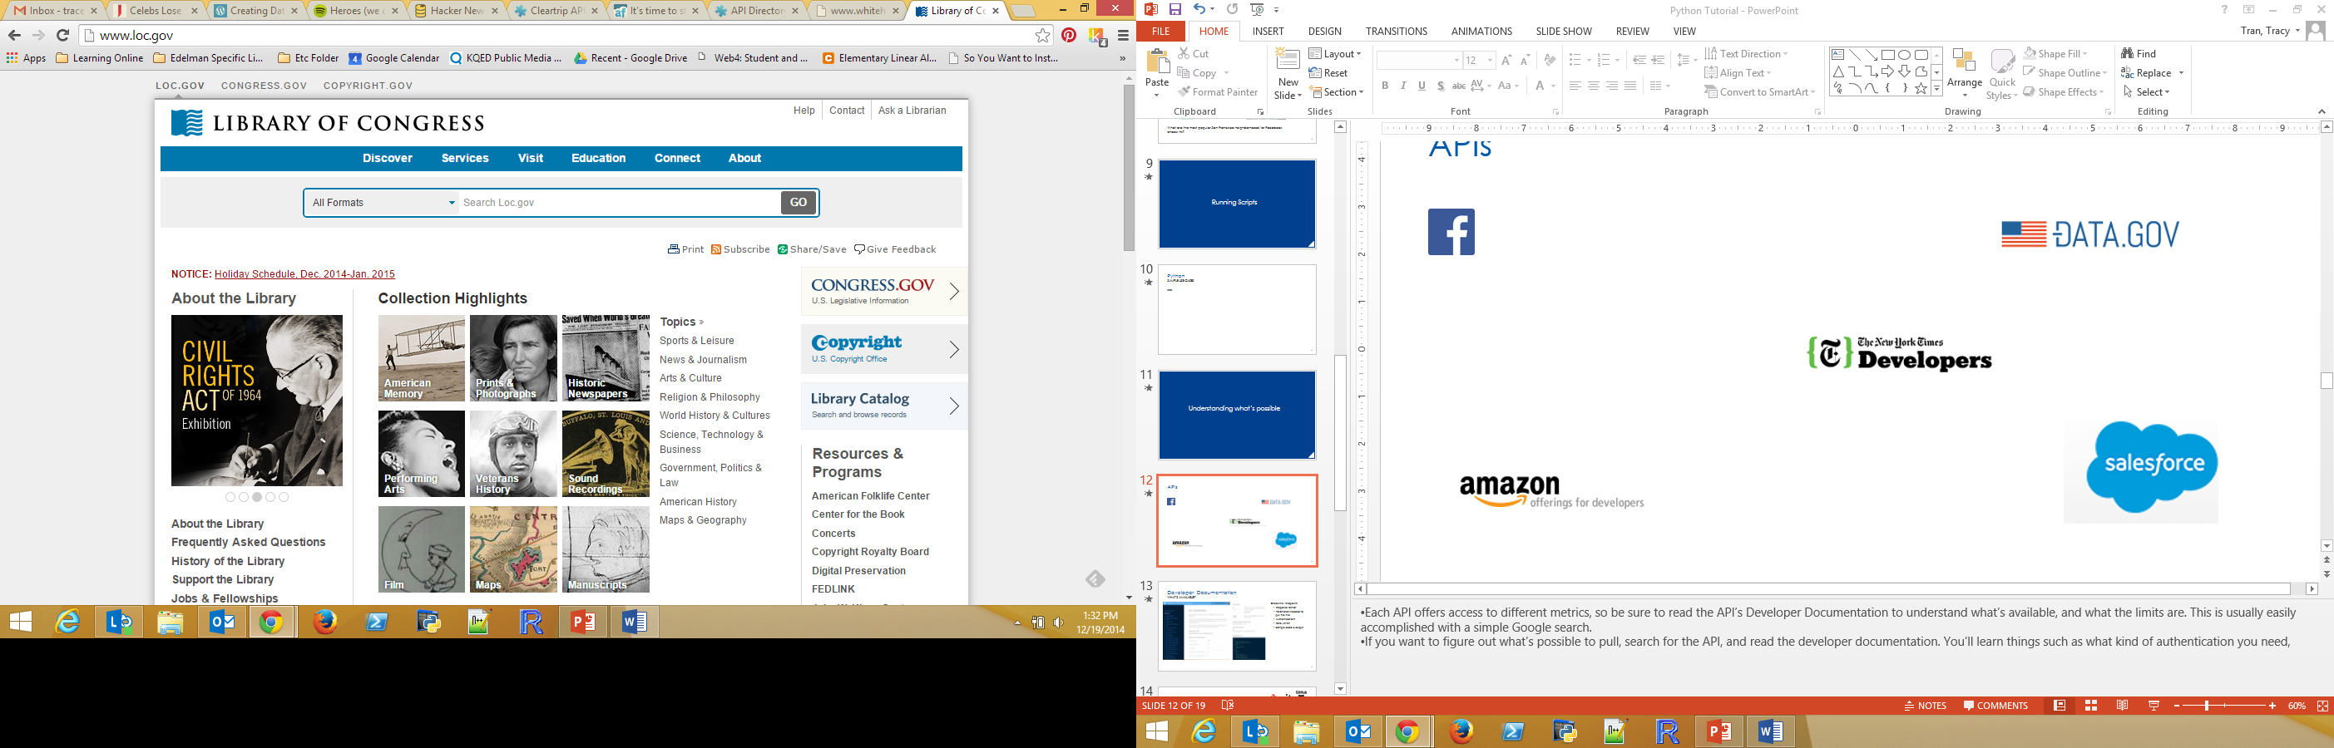

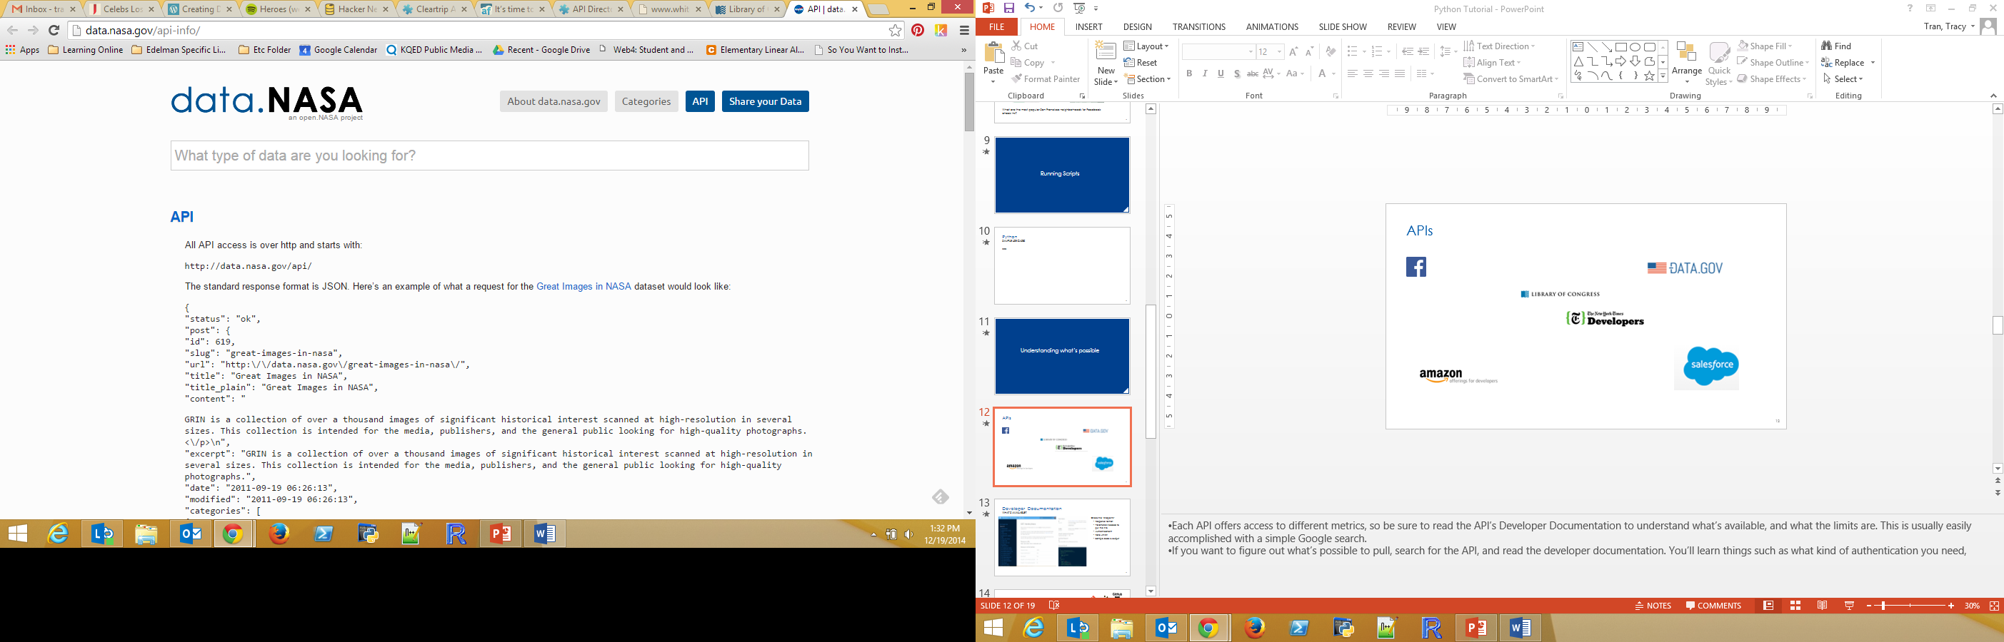



APIs- Sharing Information
Notes:
It’s not only tech companies with APIs. Large companies such as Walgreens or FedEx offer APIs. Media companies such as the New York Times or NPR. There is also a large government presence. In fact, the US government has an official API strategy.
Each API offers access to different metrics, so be sure to read the API’s Developer Documentation to understand what’s available, and what the limits are.
If you want to figure out what’s possible to pull, search for the API, and read the developer documentation.

Slide 18
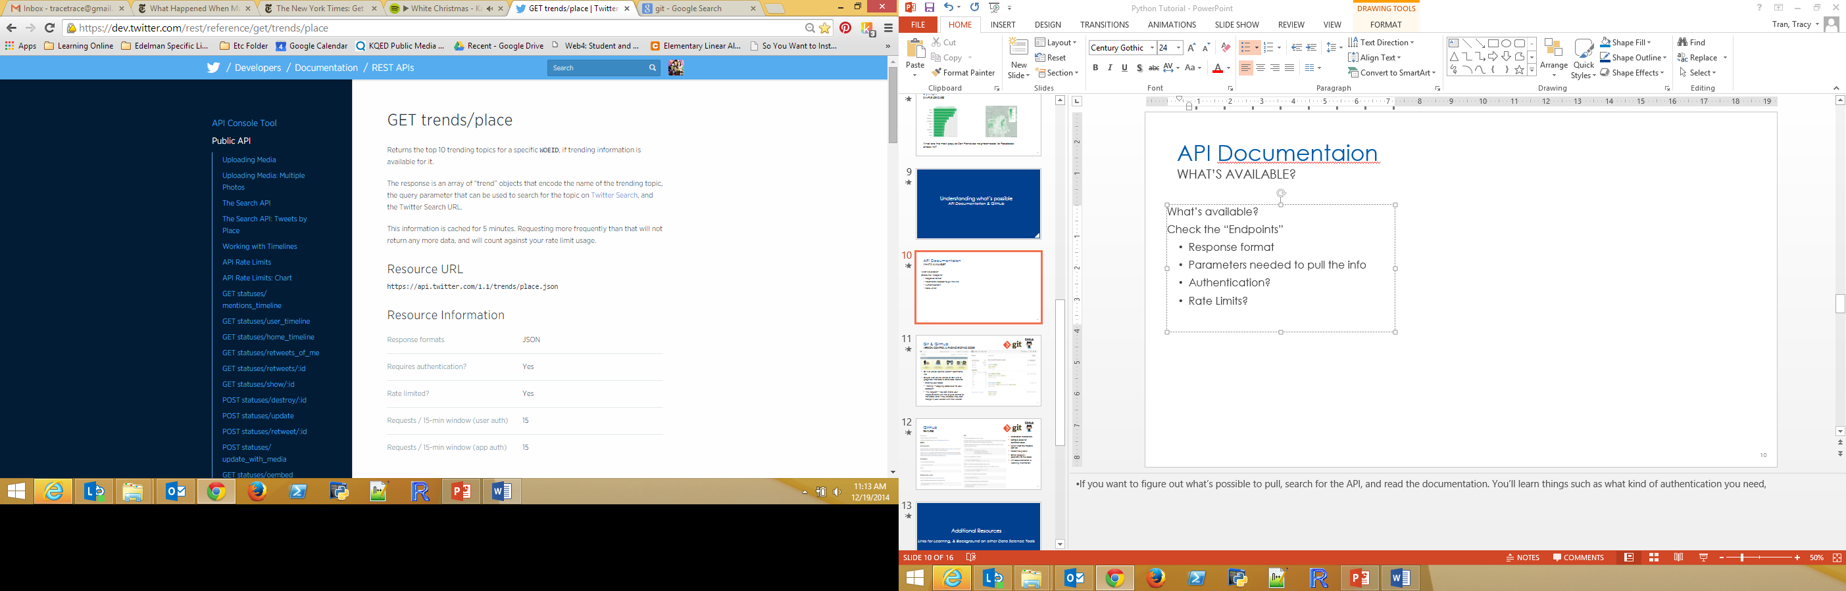
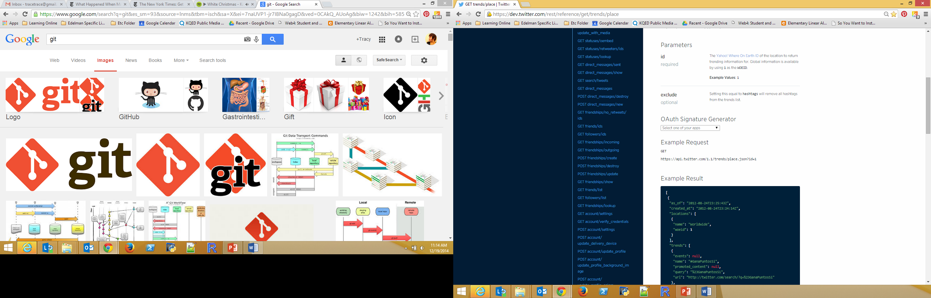
Developer Documentation
What’s available?
Specifies available data
Response format (the output)
Parameters needed to pull the data
Authentication
Rate Limits
Sample code & output
Notes:
Let’s look at the Developer documentation for Twitter. Here you’ll see for example that when you use the Get Trends function you will receive a response that is in the “JSON” format. Also we can see that using this feature requires authentication. There is a limit to how many times you can ping the Twitter API for this data. In this case, 15 times per 15 min.

Slide 19
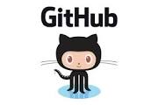
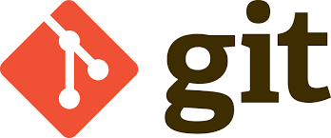
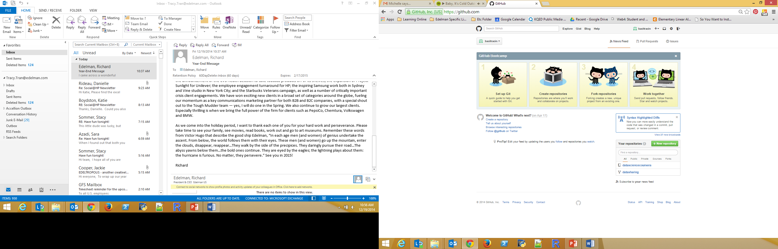
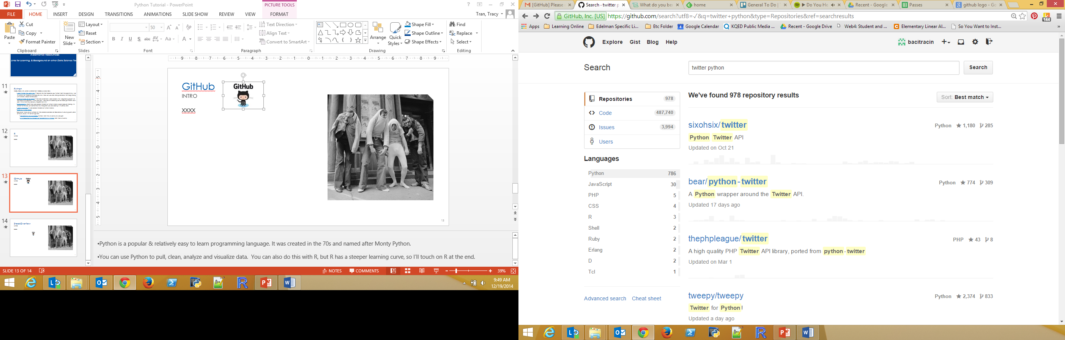
Git & GitHub
Version control & finding existing code
Git is a version control system- command line
GitHub is an online version of Git, with a graphical interface & some cool features. It’s kind of like a social network / online portfolio for programmers.
Sharing your code
“Forking” – copying code over to your account
“Pull request”- You can share your improvements with the original author of the code, and if they choose, they can merge in your version with their version
Notes:
The main functionality of GitHub is “forking” – this is copying a repository from one user’s account to another. This enables you to take a project that you don’t have write access to and modify it under your own account.
If you make changes that you would like to share, you can send a notification called a “pull request” to the original code owner. That user can then easily merge the changes found in your version with their version.
GitHub is useful for figuring out if somebody’s already written out the code you need. Also it can help you figure out which module you should dl, which is great because a lot of social media modules have the incredibly similar names: python twitter, twitter python, etc.
So in the example above on the right, I’ve searched for any Twitter programs that use python. There are 978 options. I can click through each to learn more about the program.

Slide 20
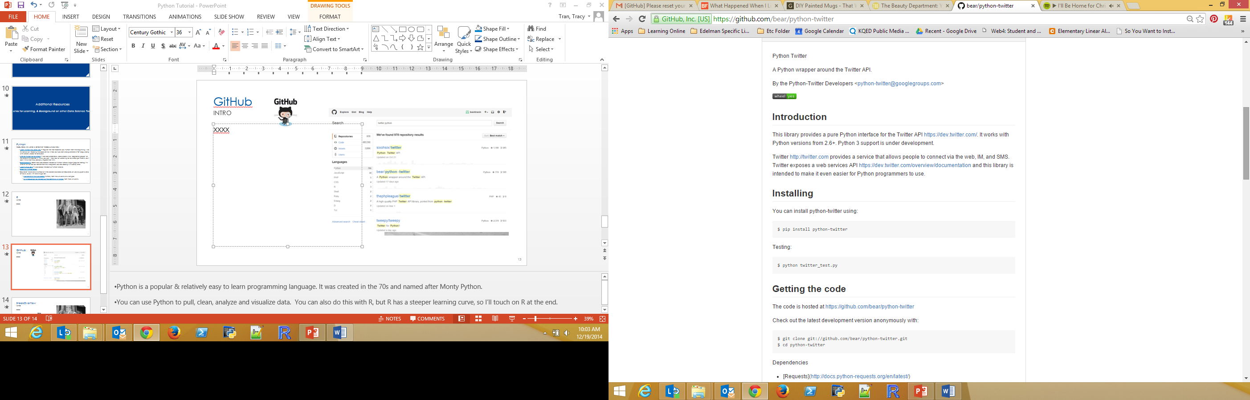
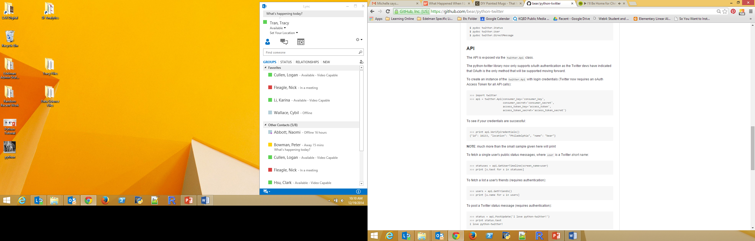
GitHub
Exploring code & modules
Installation instructions
Sample code for common tasks
List of what the module can do
Recent bug edits
Other people’s additions to the code
API documentation & licensing information
Notes:
Here is the documentation for the module “Python Twitter”

Slide 21
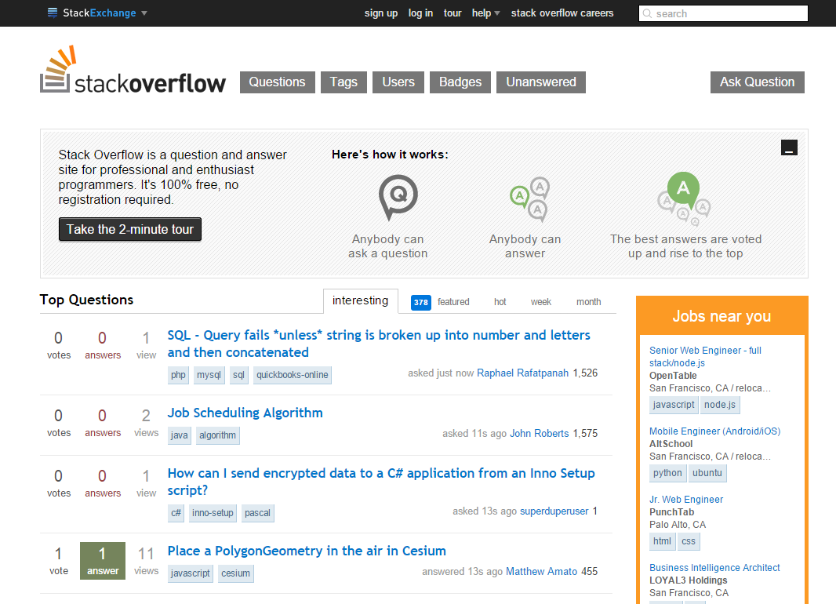
StackOverflow
Q & A Site
Q&A site for programming questions.
It’s quite likely that others have already asked your questions.
Sort by “Tags” or copy & paste your Error message
If you sign up and ask a question, be sure to be incredibly specific with your problem.

Slide 22
Additional Resources Links for Learning, & Background on other Data Science Tools

Slide 23
Python
Resources are listed in order of recommendation
CodeSchool’s Monty-Python themed intro track – Just launched, but I love CodeSchool.
Learn Python the Hard Way – Popular site that teaches you Python from the beginning. I like this one a lot. Reading the book online is free, but you can also purchase a PDF copy along with tutorial videos for 30 bucks.
Intro to Python on Skillshare – Free conversational video lessons. The instructor is very approachable. The “capstone project” at the end of this course is building a program that helps you cheat at Scrabble. I think you get 1 free hour of watching on Skillshare per month, but I don’t think that they actually impose that limit.
Codecademy- Gamified web based interactive Python tutorial. Super popular startup. It’s kind of fun to use, but sometimes it’s really buggy.
LearnPython.Org – Web based interactive Python tutorial.
Google’s Python Class
Coursera- There are a number of intro classes available on Coursera, of varying quality and difficulty levels.
Programming for Everybody(Python) from the University of Michigan
An Introduction to Interactive Programming in Python from Rice University
For installation: Here are two tutorials for getting set up in the most stripped down fashion.

Slide 24

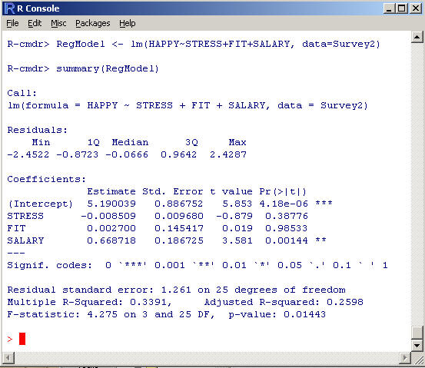
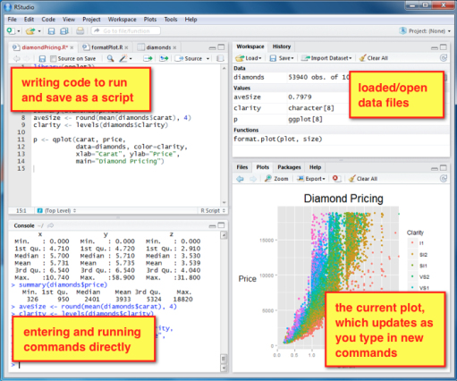
R
Stats
Language & environment for statistical computer & graphics. Free & open source
Often used by academics, so tons of great stats & data viz modules out there
Great complement to Python. Pull the data with Python, make the pretty charts with R!
Learning Resources
CodeSchool
Swirl
Rstudio- A must! Great IDE for R
Notes:
R- R is a language & environment for statistical computing and graphics (often used by academics). Generally R is used for cleaning, analyzing and visualizing data. You can also pull data with R too, but that’s not what it’s famous for. R has a huge open source module library, so what you’re looking for might already have been created. R has a reputation for being hard to learn.
CodeSchool- A pirate themed tutorial within a web browser, no need to download anything. Free.
Swirl- This is a module that you install that teaches you R within R. Free.
If you decide to learn R, be sure to download RStudio! It’s a much nicer environment to work in.

